Slide 1

RANDOM VARIABLES AND DISTRIBUTIONS

Slide 2


Random variables and distributions
It is a variable for which or we don’t know the hidden rules which determine the outcome or they are too many to take into consideration.
A random variable can take any value in a given range. Some examples of random variables:
The outcome of a coin launch (H,T)
A dice launch (1,2,3,4,5,6)
The card taken from a deck (...)
The score of the next football game
The next winning combination of the lottery
The average time that a raindrop takes to reach the bottom of the window.
What is a random variable?

Slide 3
Random variables and distributions
Random variables can be classified in two groups:
Continuous variables can take any numerical value. (amounts)
Discrete variables can only take specific values (labels)
We can convert a continuous variable into discrete if we create bins/ranges of values (ie: groups of ages).
Continuous and discrete random variables

Slide 4
Random variables and distributions
The frequency of a discrete value is how many times this value showed up divided by the total amount of trials. (is an estimation of the probability to show up)
We can do this for all the possible values of the discrete variable.
However, if the number of trials is finite the computed frequencies will be only an estimation of the real value.
The bigger the number of trials, the better the estimation (sample size)
Frequencies. Discrete variables

Slide 5
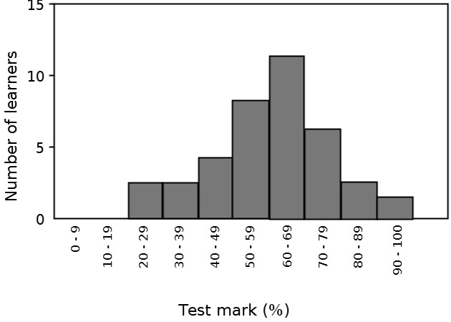
Random variables and distributions
We can plot the frequencies of each possible value in a plot named: histogram.
Discrete variables: histograms

Slide 6
Random variables and distributions
If the number of possible values of a discrete variables starts to grow, then the width of the histogram’s bars will start to shrink to almost nothing
If we place a dot in the top of each bar, and we join the all the dots, we obtain a continuous line.
The resulting shape of this line is what we call distribution.
Distributions can take many different shapes, but not all the shapes them are good for data analytics.
Frequencies. Continuous variables

Slide 7
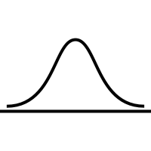
Random variables and distributions
The standard distribution is the “holy grail” of a data analyst because is the best suited for predictive purposes.
This distribution has the following properties:
is symmetrical around the center (Mean = mode = median)
It decays quickly to zero for high and low values of the variable
Normal distribution

Slide 8
Random variables and distributions
The Standard distribution is a particular case of an normal distribution in which:
Mean = 0
Standard deviation = 1
Standard distribution
Mean = 0

Slide 9

Random variables and distributions
Computers can’t generate random numbers!
BUT there a procedures ( algorithms ) to generate sequences of numbers which has the same statistical properties as any sequence of real random numbers.
However those sequences are finite! Therefore, when the last number of the sequence is finished it starts over from the beginning.
Those algorithms resemble a “ring”. The sequence starts over when all the values are shown. We can specify in which point from the ring we want to start to generate numbers.
“Generating random numbers (I)”

Slide 10
Random variables and distributions
To generate random numbers you can use the function random() from np.random
However, this function generates random numbers in the range [0,1) all of them with the same probability.
Can you guess the shape of the distribution of probability?
“Generating random numbers (II)”

Slide 11
Random variables and distributions
What if we want to generate random numbers according to another distribution of probability?
Then we make use of another Python library called Scipy:
https://scipy.org/
“Generating random numbers (III)”

